Slide 1
Step 7 DevOps using ARM
Stephane Lapointe
MVP Azure, Cloud Solution Specialist - GSOFT
https://codeisahighway.com

Slide 2
Goal
Automate the creation of the resources required by the application in Azure using Infrastructure as Code (IaC) & Visual Studio Resource Group project.

Slide 3
Azure Resource Manager
enable application management within Azure
resource groups are containers that can contain multiple IaaS + PaaS resources
support lifecycle management with integrated Role Based Access Control (RBAC)
templatize application deployment and configuration
supports DevOps

Slide 4
imperative or declarative
New-AzureRmVM –VM $myVM
New-AzureRmStorageAccount –StorageAccountName $acct
Set-AzureRmVirtualNetwork –VirtualNetwork $vnet
New-AzureRmKeyVault –VaultName $myVaultName
{
"$schema": "https://../deploymentTemplate.json#",
"contentVersion": "1.0.0.0",
"parameters": {},
"variables": {},
"resources": [],
"outputs": {}
}
You decide

Slide 5

Resource Group
container for multiple resources
resources exist in one* resource group
resource groups can span regions
resource groups can span services
support both imperative and declarative deployment models
RESOU
R
CE G
R
OUP
*and only one
Notes:
Best practices: RG should be in same region as controlled resources in case of problem with the data center.
1 Resource Group can hold up to 800 deployments
Resource group’s location is for his Metadata

Slide 6
Deployment
tracks template execution
hold one or many deployment operations
created within a resource group
allows nested deployments
RESOU
R
CE G
R
OUP
Notes:
A deployment can only span 1 Resource Group

Slide 7
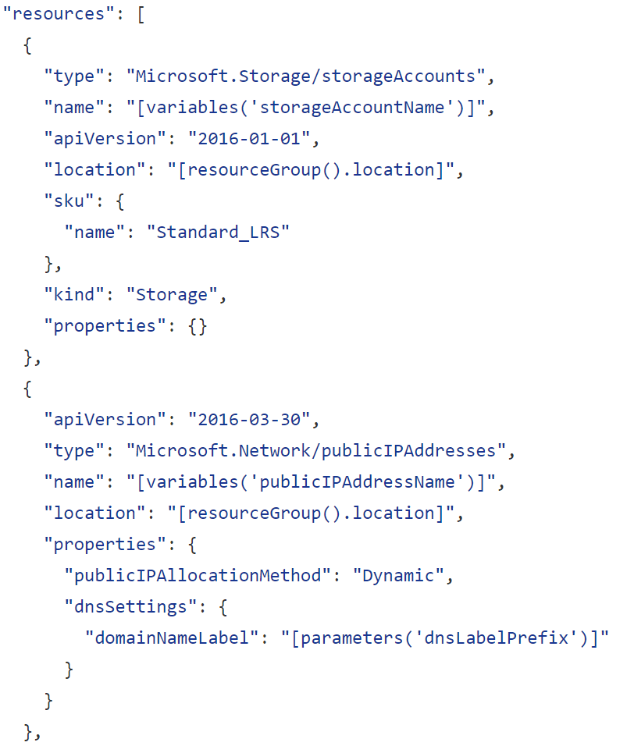
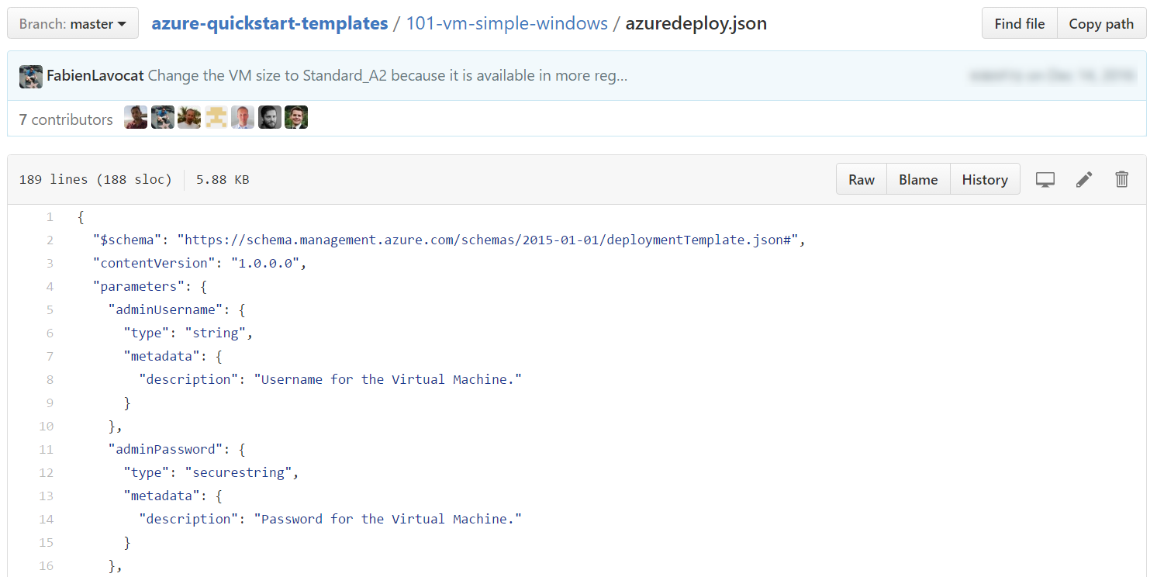
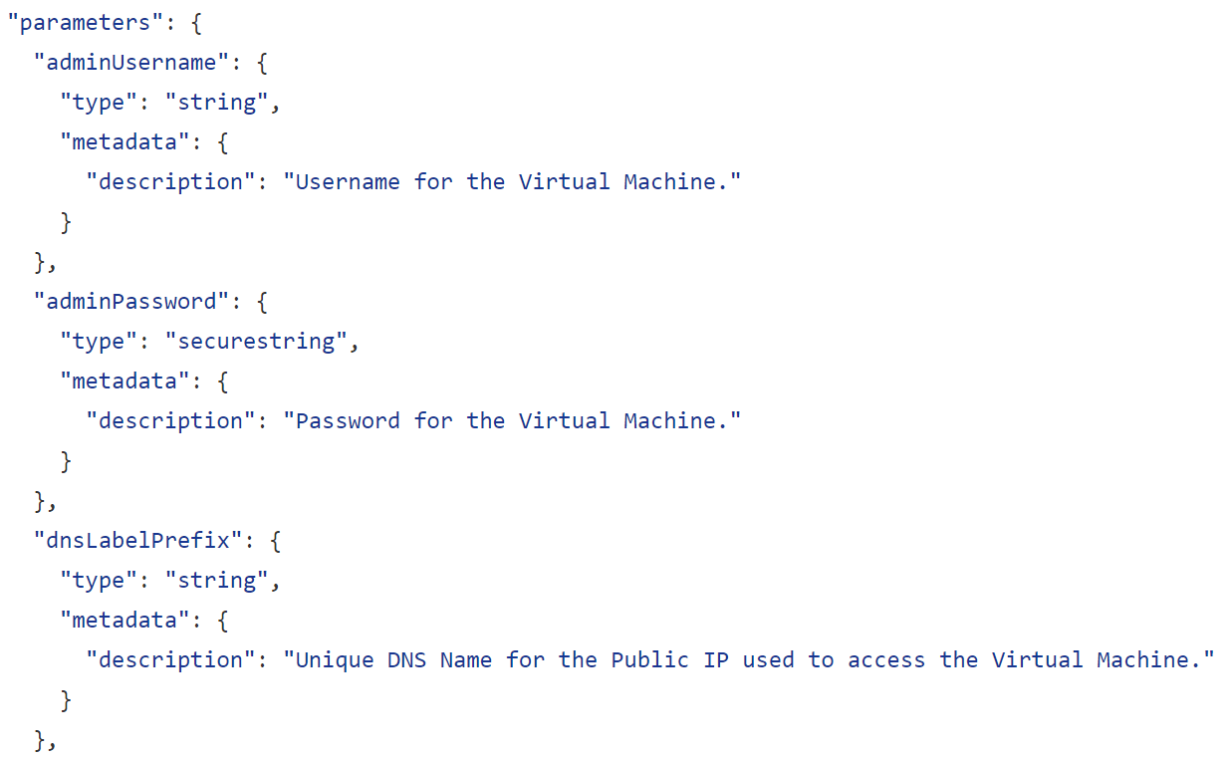
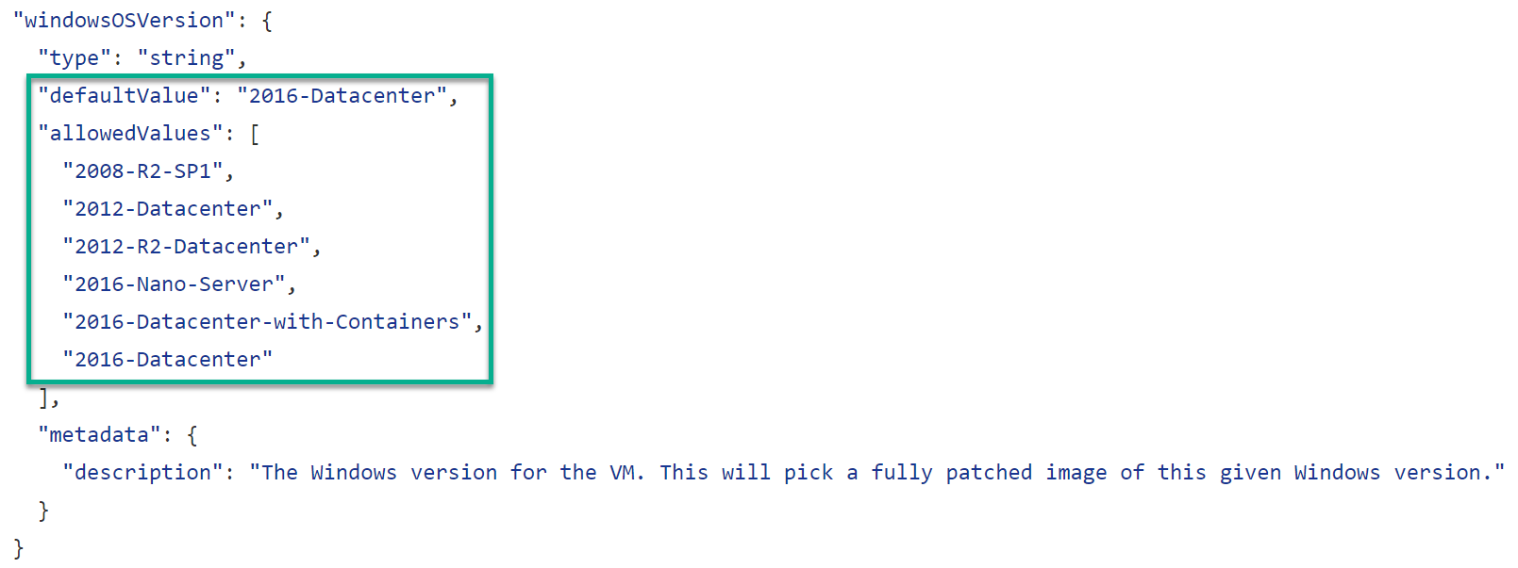
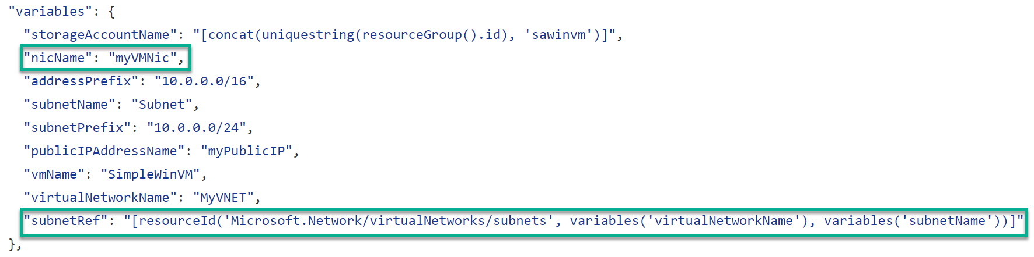

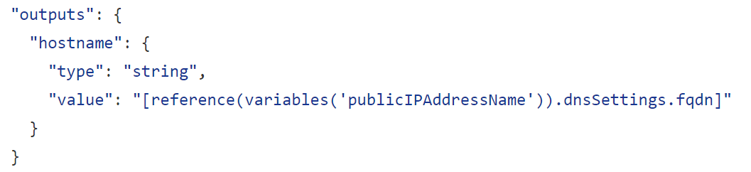
JSON files—simpler than they look Schema, content version, parameters, variables, resources, and outputs
Notes:
A JSON template file is a text file that contains descriptions of the resources, configurations code and extensions. JSON templates are idempotent, which means that they can be run multiple times without changing the outcome beyond initial deployment. A consequence of this characteristic is that templates can be used to upgrade applications, for example, by scaling out applications with additional VMs. You modify the template to include the specifications for the additional virtual machines. When you deploy the template, Azure Resource Manager will recognize the resources that have previously been deployed and create only the resources that have been added.
A JSON template is divided into sections:
<CLICK> The $schema (a required element that provides the location of the file that describes the version of the template language) along with a required element that provides the version of the template
The schema reference is used by intelligent JSON clients to determine the schema that is applicable to the JSON file and to provide additional functionality such as autocomplete and intellisense.
<CLICK> Parameters (optional elements that define values that are passed in when the template is executed)
The value for the Parameters key is an array of parameter objects that representing the dynamic input for the JSON template. Each of the parameter objects has a name that is used pass values in at runtime and is referenced within the JSON itself in other sections. For example, "NewStorageAccount" is the name of the parameter that is supplied as an input and used to provide the name of the storage account resource specified in the JSON file.
<CLICK> Variables (optional elements that define the values that are used when template is executed)
<CLICK> Resources (a required element that defines the resources that are deployed or updated in a resource group); and
<CLICK> You can also have an optional Outputs section that defines values that are returned after a deployment
<CLICK> A JSON file is constructed of key/value pairs. For example, in the image above, "ContentVersion" is the key and "1.0.0.0" is the value. A key is always a string enclosed in quotation marks. A value can be a string, securestring, number, boolean expression, array, or object. A JSON object is enclosed in curly braces, "{ }". In a key/value pair the key is always followed by a colon. Key/pairs are separated by commas.
A JSON template may also contain functions and expressions. Expression are enclosed in square brackets, "[ ]', and can appear anywhere in a JSON string. Functions calls have the format functionName(arg1,arg2,arg3). Properties are referenced using the dot and index operators.
The lab provides notes with additional details regarding specific parameters, variables, resources, etc.
Authoring Azure Resource Manager templates
https://azure.microsoft.com/en-us/documentation/articles/resource-group-authoring-templates/

Slide 8

Template language expressions
Extend JSON that is normally available in template
Enable values that are not strict literal values
Can be placed anywhere there is a JSON string
Expressions are enclosed with brakets [ ]
Evaluated at deployment time
Typically used with functions to configure deployment
Reference properties using dot (.) and [index] operator

Slide 9
Let’s code!

Slide 10
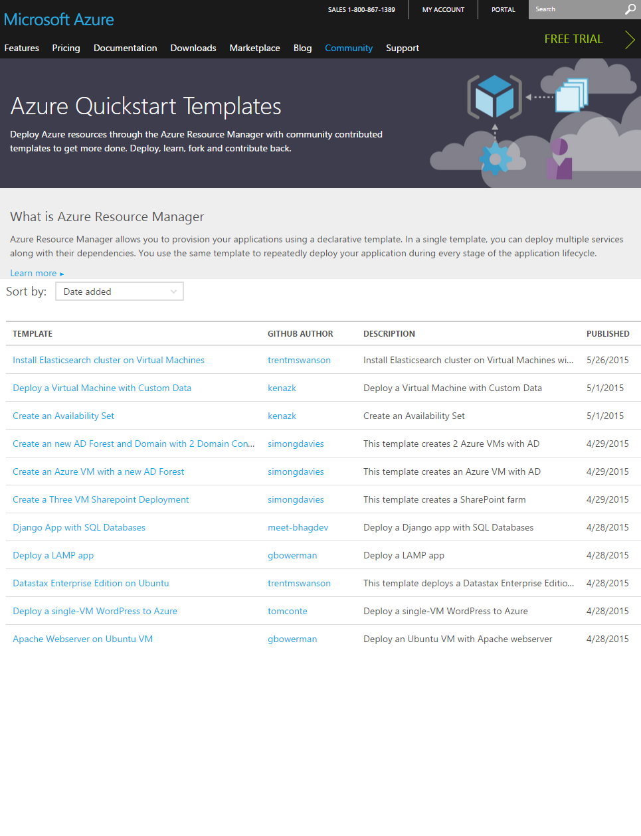
Getting started with Azure templates
Using Azure Resource Manager
Download template and parameters in Create panel (Portal)
Export Template from previous deployments
Export Template from running Resource Group
Wide range of Quickstart templates
Indexed on Azure.com
GitHub repo
Community and Microsoft contributed
Many examples available @ https://github.com/Azure/azure-quickstart-templates
Notes:
Best practices for designing Azure Resource Manager templates
https://azure.microsoft.com/en-us/documentation/articles/best-practices-resource-manager-design-templates/
Also, see Appendix for additional slides on this topic

Slide 11

Resources
Azure Resource Manager QuickStart Templates https://github.com/Azure/azure-quickstart-templates
Azure Resource Manager Template Functions https://docs.microsoft.com/en-us/azure/azure-resource-manager/resource-group-template-functions
Azure Resource Explorer https://resources.azure.com
Try Azure for free. Sign up for a free one-month trial. aka.ms/TryAzureForMonth

